Slide 1

Apache Kafka – Stream Processing
Dilip Rao Krishna Murthy
Hitesh Bhavsar

Slide 2
Meet Kafka
Before discussing the specifics of Apache Kafka, it is important for us to understand the concept of publish/subscribe messaging.
Publish/subscribe messaging is a pattern that is characterized by the sender (publisher) of a piece of data (message) not specifically directing it to a receiver. Instead, the publisher classifies the message somehow, and that receiver (subscriber) subscribes to receive certain classes of messages.
Pub/sub systems often have a broker, a central point where messages are published, to facilitate this.

Slide 3

How it starts?
Many use cases for publish/subscribe start out the same way: with a simple message queue or interprocess communication channel.
For example, you create an application that needs to send monitoring information somewhere, so you write in a direct connection from your application to an app that displays your metrics on a dashboard, and push metrics over that connection
A single, direct metrics publisher

Slide 4
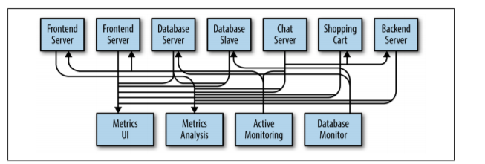
Many metrics publishers, using direct connections
Over the time , the system architecture increases complexities :
Now it adds a few more servers. And a few more functionalities
This architecture as depicted above, with connections that are even harder to trace

Slide 5
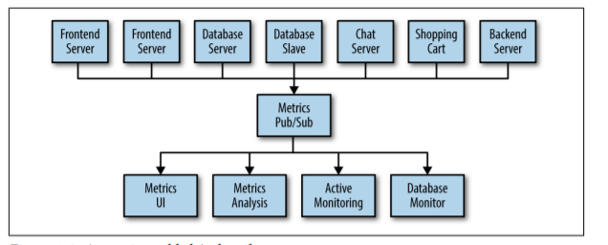
A metrics publish/subscribe system
You set up a single application that receives metrics from all the applications out there.
And provide a server to query those metrics for any system that needs them. This reduces the complexity of the architecture to something similar to the pic below.
A metrics publish/subscribe system

Slide 6
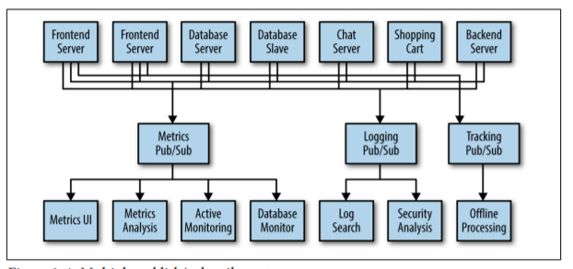
Multiple publish/subscribe systems

Slide 7
What is Stream Processing?
Stream processing is the processing of data in motion, or in other words, computing on data directly as it is produced or received.
The majority of data are born as continuous streams: sensor events, user activity on a website, financial trades, and so on – all these data are created as a series of events over time.

Slide 8
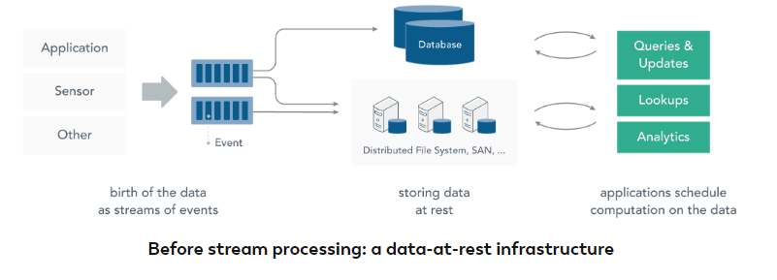
Before Stream Processing
Before stream processing, this data was often stored in a database, a file system, or other forms of mass storage. Applications would query the data or compute over the data as needed.

Slide 9
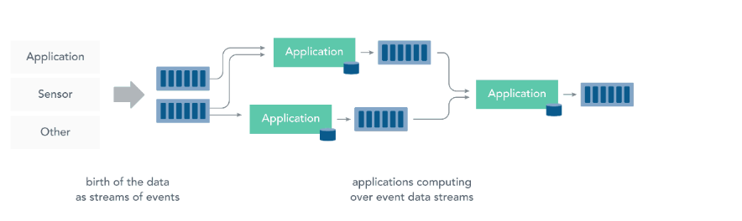
With Streams
Stream Processing turns this paradigm around: The application logic, analytics, and queries exist continuously, and data flows through them continuously. Upon receiving an event from the stream, a stream processing application reacts to that event: it may trigger an action, update an aggregate or other statistic, or “remember” that event for future reference.
Streaming computations can also process multiple data streams jointly, and each computation over the event data stream may produce other event data streams.

Slide 10

A streaming platform has three key capabilities:
Publish and subscribe to streams of records, similar to a message queue or enterprise messaging system.
Store streams of records in a fault-tolerant durable way.
Process streams of records as they occur.

Slide 11
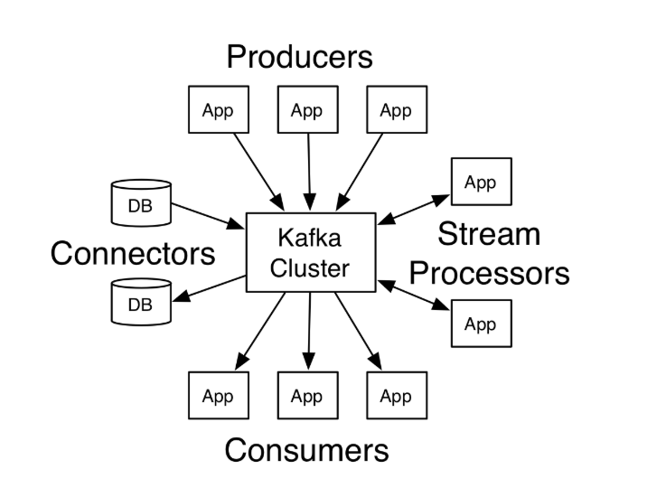
Kafka has four core APIs:
The Producer API allows an application to publish a stream of records to one or more Kafka topics.
The Consumer API allows an application to subscribe to one or more topics and process the stream of records produced to them.
The Streams API allows an application to act as a stream processor, consuming an input stream from one or more topics and producing an output stream to one or more output topics, effectively transforming the input streams to output streams.
The Connector API allows building and running reusable producers or consumers that connect Kafka topics to existing applications or data systems. For example, a connector to a relational database might capture every change to a table.

